Slide 1


Analysis of Cardiotocography Features and Their Impact on Foetal Health
1

Slide 2

OUTLINE
01
02
03
04
05
06
Project Overview
Analytical Insights (EDA)
Data
Processing
Model
Comparative
Analysis
Conclusion
Recommendations
2

Slide 3






PROJECT OVERVIEW
SIGNIFICANCE
PROBLEM
SOLUTION
Predict complications, aiding in early intervention
Early childhood mortality
Maternal mortality
Early foetal health prediction
Indicators of foetal health
3

Slide 4

ANALYTICAL INSIGHTS
4

Slide 5
DATASETS
CTG Dataset
Number of Observations: 2126
Number of Features: 22
5

Slide 6
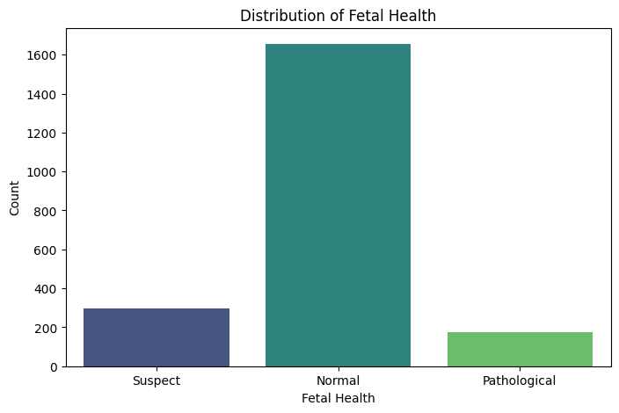
DATA DISTRIBUTION
6

Slide 7
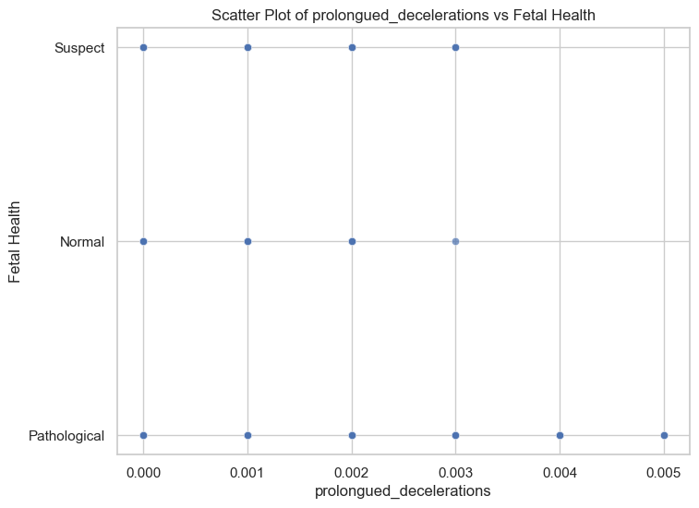
EXPLORATORY DATA ANALYSIS
8

Slide 8
EXPLORATORY DATA ANALYSIS
8

Slide 9
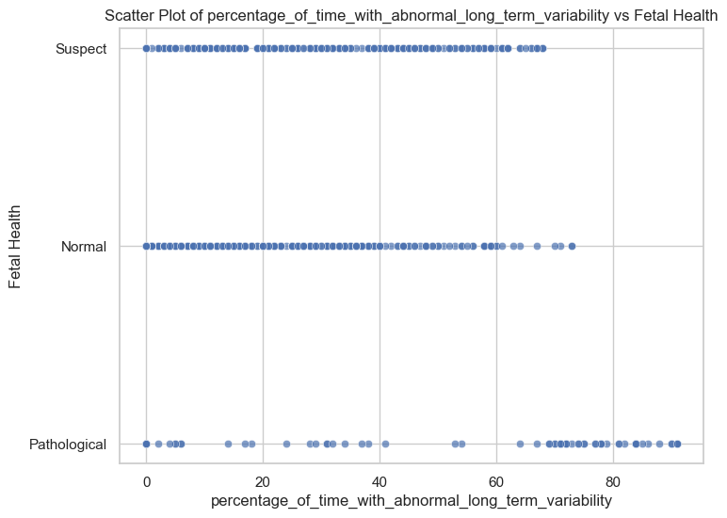
EXPLORATORY DATA ANALYSIS
9

Slide 10
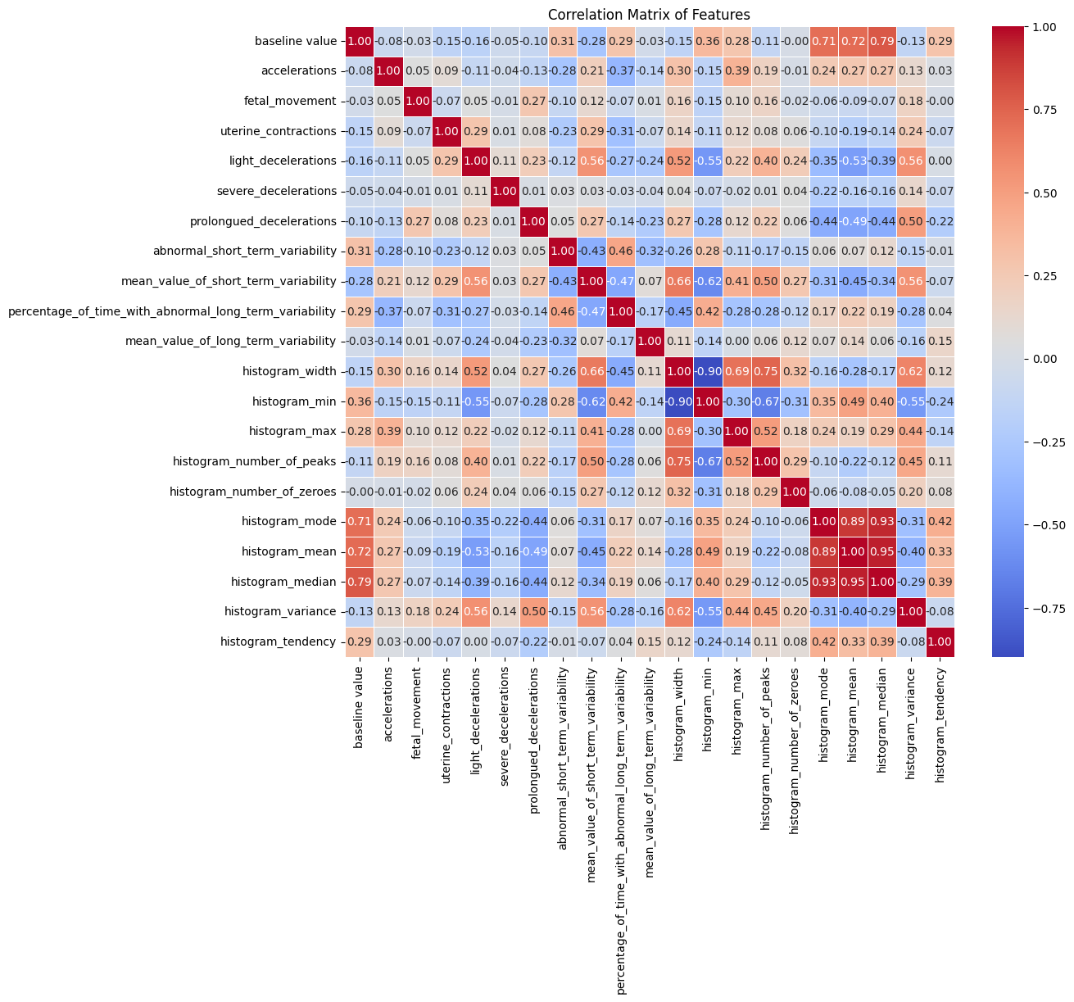
CORRELATION MATRIX
7

Slide 11
CORRELATION MATRIX
High Positive Correlation
Histogram Median and Histogram Mean (0.95)
Mean of Short Term Variability and Histogram Width (0.66)
High Negative Correlation
Histogram Width and Histogram Min (-0.89)
Histogram Variance and Histogram Min (-0.55)
7

Slide 12
FURTHER INSIGHTS
High FHR Histogram Measures of Central Tendencies often indicate Pathological Foetal Health
High FHR Histogram Measures of Spread often indicate Pathological Foetal Health
10

Slide 13
DATA PROCESSING
12

Slide 14

PRE PROCESSING
This is done so as to:
Normalise the Features
Enhance Model Performance
Handle Different Units
Standardization
Missing /Null Values
13

Slide 15
PRE PROCESSING
This is done so as to:
Reduce Dimentionality to 14 features (95% of Variance)
Compare PCA-Transformed data with Original Data in Model Performance
Principal Component Analysis (PCA)
Missing /Null Values
13

Slide 16


Ensemble Based Learning
(Random Forest Classifier)
ML ALGORITHMS
Instance Based Learning
(K-Nearest Neighbors Classifier
Performance of both models to be compared using PCA and Original data
16

Slide 17
MODELS COMPARATIVE ANALYSIS
17

Slide 18
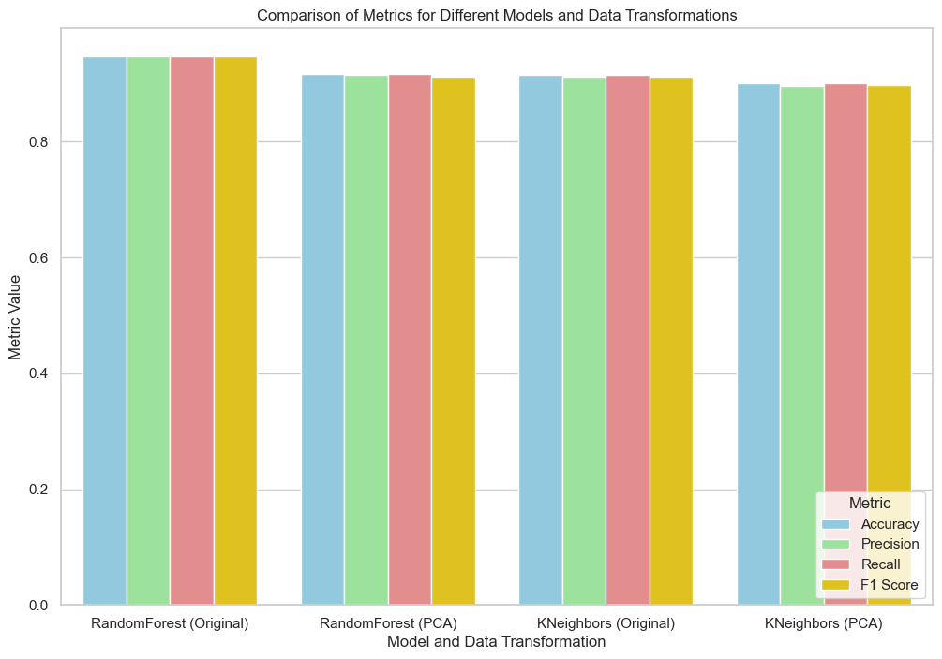
MODEL EVALUATION
18

Slide 19
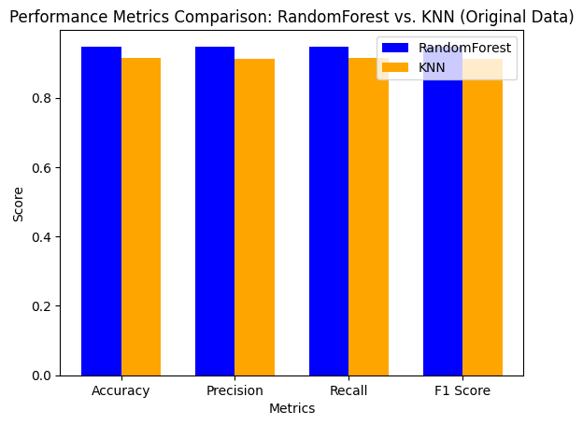
MODEL EVALUATION
19

Slide 20
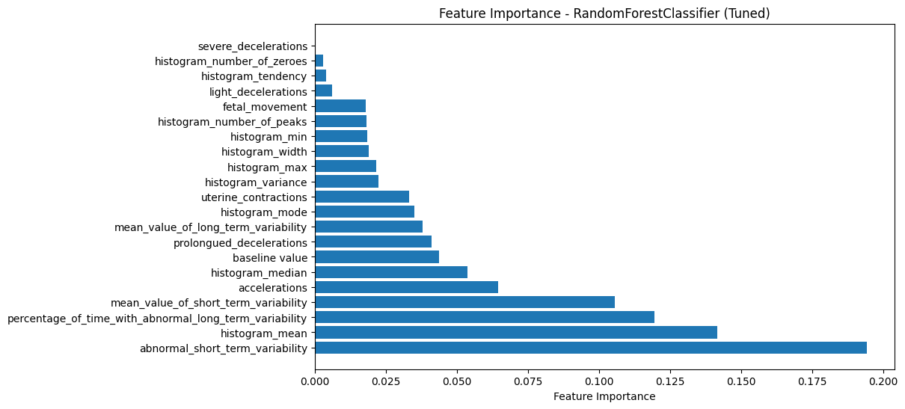
FEATURE IMPORTANCE
21

Slide 21
CONCLUSION
25

Slide 22


01
Significant Features
Abnormal Short Term Variability
FHR Histogram Statistical Features
Acceleration & Deceleration Features
26

Slide 23
02
Best Predictive Model
Random Forest Classifier with the Original Data
26

Slide 24
RECOMMENDATIONS
25

Slide 25
01
Collaboration With Domain Experts
02
Continuous Algorithm Assessment
03
Exploration of Other Data Sources
27

Slide 26

THANK YOU

